Slide 1
The Road to Net Zero: Strategies Towards Achieving Sustainability

Slide 2
Introduction
Russell Peacock- Senior Director, Facility Operations and Property Management, Florida Blue/GuideWell for 15 years
Manage approximately 5 million square feet owned/leased property
Reduced Total GHG Emissions by 61% in 7 years
Corporate Campus Energy reduction by 53%. Energy cost reduction over 1 million annually
Notes:
GuideWell Mutual Holding Corporation (GuideWell) is a not-for-profit mutual holding company and the parent to a family of forward-thinking companies focused on transforming health care. The GuideWell organization includes the leading health insurance company in Florida; a portfolio of clinical delivery organizations, a provider of administrative services to state and federal health care programs; and a leader in risk adjustment and population care management. The GuideWell enterprise serves 48 million people in 45 states and Puerto Rico and is headquartered in Jacksonville, Fla.

Slide 3
What is Net Zero?
Carbon Neutrality or Net Zero means that any Carbon Dioxide (or other Greenhouse Gas) released into the atmosphere by your company’s business operations is balanced by an equivalent amount being removed.

Slide 4
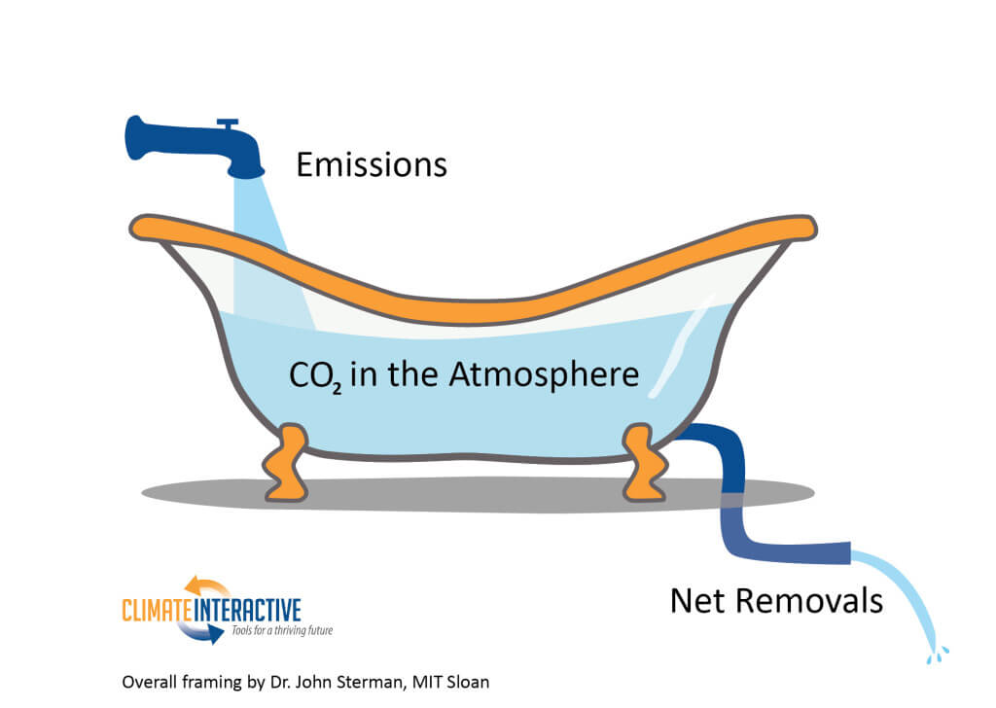
Achieving Net Zero
et zero is achieved by balancing the input (emissions) and net removals

Slide 5
Strategy For the Road to Net Zero
Identify Emission Sources
Quantify Emissions through Greenhouse Gas Emission Reports
Reduce Emissions
Process changes
Efficiency
Eliminate/Reduce fossil fuel usage
Offsets

Slide 6
Notes:
2019 = 6,558 Million Metric Tons of CO2 equivalent.
In 2020, U.S. greenhouse gas emissions totaled 5,215.6 million metric tons of carbon dioxide equivalents after accounting for sequestration from the land sector. Emissions decreased from 2019 to 2020 by 11 percent (after accounting for sequestration from the land sector).
The electric power sector (which accounts for 28% of net US emissions) saw the second largest decline in GHG emissions from 2019 levels, dropping 167 million metric tons (or 10.3%) below 2019 levels (Figure 4). This was driven almost exclusively from the continued rapid decline of coal-fired power generation, rather than a drop in electricity demand (which was down only 2% year-on-year).
As a result, the transportation sector, which accounts for 31% of net US emissions, experienced the largest decline in GHG emissions, dropping 273 million metric tons below 2019 levels, dwarfing the modest decline between 2018-2019 of 8 million tons of CO₂e .

Slide 7
Greenhouse Gas Reporting – Why Report
May Be Required by Law – EPA requires reporting from Large Greenhouse Gas Emission Sources defined as exceeding 25,000 metric tons CO2e (Scope 1)
Some States have GHG Reporting Requirments -California, Connecticut, Delaware, Florida (electric utilities), Iowa, New Mexico, North Carolina, Washington, West Virginia, Wisconsin

Slide 8
Greenhouse Gas Reporting – Why Report?
Protect Companies Reputation
Boost Competitive Advantage
Get Ahead of Regulation
Uncover risks and opportunities
Track and Benchmark Progress
30% of Fortune 500 companies have publicly committed to a GHG reduction goal.
Notes:
Reputation/competitive advantage – Many younger consumers exert pressure with how they spend money. If your company is not advocating socially responsible practices, they will go to competitors

Slide 9
What is CO2e?
Carbon Dioxide Equivalent or CO2e is a term for describing different greenhouse gases in a common unit. CO2e signifies the amount of CO2 which would have the equivalent global warming impact.
Example: Refrigerant R-134 used in chiller plants has a global warming impact factor of 1400. 1 ton R-134 equals 1400 tons CO2e.

Slide 10
Greenhouse Gas Reporting – How?
Review all processes that have direct emissions to the environment such as company owned vehicles (automobiles, trucks, planes), emergency generators, HVAC systems, any work processes that cause emissions.
Gather information on utility usage.
Review all emissions in your supply and distribution chain to determine which Scope 3 emissions to report (voluntary).
Notes:
May have significant emissions based on the type of products/services produced
Electrical usage information may be more difficult for leased properties depending on how your utilities costs are structured in you lease. For GuideWell, we had over 175 properties to gather information on.
Scope 3 emissions to report can be determined as your program matures.

Slide 11
Greenhouse Gas Reporting – How?
Calculational tools to convert usage information into CO2e
Numerous
Environmental Protection Agency
Greenhouse Gas Protocol
Other commercially available – some specialized by business
The Climate Registry – Calculation tools, training, and achievement Levels
CDP –Carbon Disclosure Project – Scoring based on processes and programs. Required for Government contractors

Slide 12
Setting Boundaries
Can be complex based on your business model
Operational
Financial Control
Equity Share – Owned only 30% of a company
Notes:
Operational Control: Reflects the activities where the organization or its subsidiaries has the full authority to introduce and implement operating policies. The organization that holds the operating license for an activity typically has operational control.
Financial Control: Reflects activities where the organization has the ability to direct the financial policies of the activity with an interest in gaining economic benefits from the activity. An organization has financial control over an activity if the activity is fully consolidated in the organization’s financial accounts.
Equity Share: Reflects activities that are wholly owned and partially owned according to the organization’s equity share in each. The greenhouse gas accounted for would be equal to the total emissions times the percentage owned by the company.

Slide 13
Emission Scopes
Notes:
CO2 – Carbondioxide
CH4 – Methane
N2O – Nitrous Oxide
HFC/PFC – Hydrofluorocarbons, Perflurocarons,
Sf6 – Sulfur Hexafluoride
NF3 – Nitrogen trifluoride

Slide 14
Scope 1 Emissions
Greenhouse Gases Emitted Directly into the atmosphere by business operations. Examples:
Company Owned Vehicles
Emergency power generators
Leakage from HVAC equipment

Slide 15
Scope 2 Emissions
Indirect Emissions from Purchasing Energy
Electricity
Steam
Heating and Cooling

Slide 16
Scope 3 Emissions
All other indirect emissions that occur in a company’s value chain. Reporting of any Scope 3 emissions is not required by EPA GHG Protocol. However, Scope 3 emissions may represent a majority of emissions.
Company Travel
Waste generated
Paper usage/Resources used in production processes
Transportation and packaging of products

Slide 17
Scope 3 Emissions
Nestle’s Scope 3 Emissions are 95% of total emissions
Amazon’s Scope 3 Emissions are 79% of total emissions

Slide 18
Emission Scopes

Slide 19
Why is it important to know GHG Emission Sources?

Slide 20
Reduce Emissions
The first priority of facilities committed to climate neutrality must be to internally reduce Greenhouse Gas (GHG) emissions to the greatest extent possible through improved business processes, energy conservation measures and the installation of onsite renewable energy generation, or by purchasing green power through power purchase agreements.

Slide 21
GuideWell’s Emission Pie Chart
Scope 2 Emissions are 93% of total Scope 1 and Scope 2
Mobile combustion is 3%
Fugitive (HVAC) is 1.5%
Stationary is .5%
Scope 3 is 2%

Slide 22
Scope 2 Emissions
For most organizations, Scope 2 Emissions make up 80 to 90 percent of their carbon footprint when measuring Scope 1 and 2. So, when mapping out a plan for greenhouse gas emissions reductions, up to and including neutrality, organizations should make every effort to avoid indirect emissions by reducing energy produced by fossil fuels.

Slide 23
GuideWell’s GHG Reduction Successes 61% Reduction in 7 years

Slide 25
Energy Reduction on Deerwood Campus
Replacement of Chiller Plants with Variable Frequency machines and pumps
Replacement of interior lights with LED’s, occupancy sensors and light harvesting
Replacement of exterior lights including parking lots with LED’s
Building Management System Efficiencies
Demand Controlled Ventilation in office spaces
Resulted in over 1M annual energy cost savings

Slide 26
Jacksonville Electric Authority Energy Rebates
GuideWell has received over $400,000 in rebates from JEA through the JEA HVAC, Refrigeration and Lighting Rebate Programs.
Notes:
This is about a 10% rebate of total costs.

Slide 27
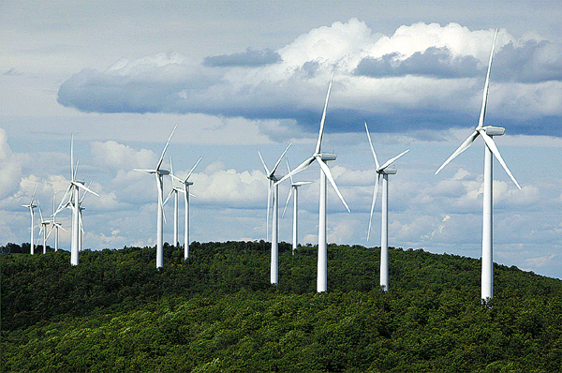
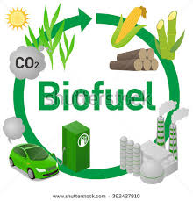
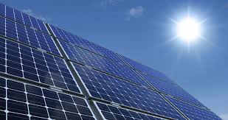
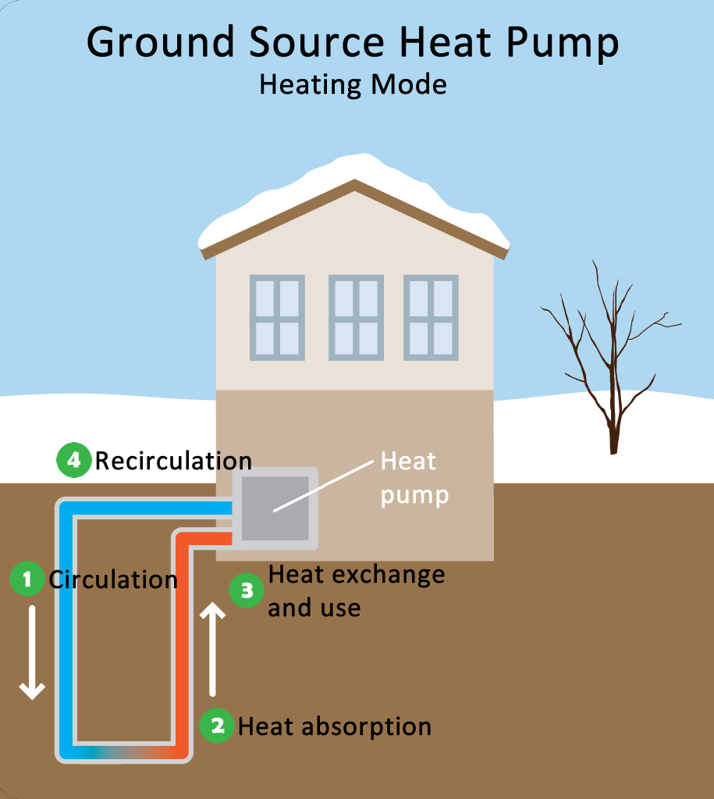
Renewable Energy
Wind
Solar
Geothermal
Wave/Hydroelectric
Notes:
Photos clockwise (starting top left) – wind turbines, water tidal turbines, wave energy, geothermal energy, solar panels, biofuels
Source: wind - https://bdn-data.s3.amazonaws.com/uploads/2009/09/1251860949_2543.jpg, solar - http://solaroregon.org/wp-content/uploads/2015/12/solar-panel-energy-orgeon-850x450_c.jpg, tidal energy - http://tidalenergytoday.com/wp-content/uploads/2017/01/orpc-shows-progress-on-maine-tidal-project.jpg, wave - https://media.salon.com/2016/08/wave_harvesters-620x412.jpg, https://www.epa.gov/sites/production/files/styles/large/public/2014-11/heat-pump-heating.pn, biofuel - https://wattsupwiththat.files.wordpress.com/2011/04/biofuellifecycle11.jpg

Slide 28
Electrical Generation Percentages in USA

Slide 29
Power Purchase Agreement
A power purchase agreement (PPA) for renewable electricity is generally defined as a contract for the purchase of power and associated renewable energy credits (RECs) from a specific renewable energy generator (the seller) to a purchaser of renewable electricity (the buyer).

Slide 30
What is an REC?
A renewable energy certificate (REC) legally conveys the environmental attributes of 1 megawatt-hour (MWh) of electricity generated from a renewable energy source (e.g., solar, wind, biomass, hydro). RECs are used to track renewable energy from the point of generation to a purchaser of green power.

Slide 31
GuideWell’s Power Purchase Agreement
At GuideWell, we entered a Power Purchase Agreement with Jacksonville Electric Authority to purchase 100% of our power from solar energy starting in late 2022/early 2023 through the JEA Solar Max Program.
When we analyzed the cost tradeoff in 2020, the cost for solar energy was slightly higher. With rising energy prices, the cost for solar will be less and is locked in for 10 years.

Slide 32
Solar Capacity Outlook in the US
According to the Financial Times:
Government forecasters predict that the U.S. will add 21.5 GW of solar capacity in 2022, which is more than half of the already existing capacity, and well more than the 15.5 GW added in 2021.
One of the biggest areas of expansion in 2021, a trend which will likely continue in 2022 and beyond, is utility-scale solar projects.

Slide 33
Solar in the US

Slide 34
Data Needed for GHG reporting
Energy Usage (Annual KWH)
Vehicles – Year, mileage, and fuel usage
HVAC systems – Refrigerant balance/usage, type of refrigerant used
On-site Power Generation – Change in Fuel in tanks plus fuel purchases, type
Other GHG generating processes

Slide 35
Third Party Verification
Verification of environmental data is an independent quality assurance that assesses the accuracy and completeness of data, reliability of data management procedures, and adherence to protocols and standards for calculating environmental metrics. Verification evaluates whether your greenhouse gas emissions data and other key environmental metrics are relevant, complete, consistent, transparent and accurate.
ISO 14064
Notes:
ISO is International Organization for Standards. This ISO provides a framework for GHG accounting and verification.

Slide 36
Reporting
Provide a link on company’s website
Social Impact Report or Environmental, Social, Governance Report
Some Websites that assist in calculation of Green House Gas Report will post on their websites for public reporting.
Public vs. Private Reports
Notes:
Once you have generated your reports how do you get them publicly reported?
Social Impact Reports and ESG reports have much more than GHG reports in them.
Public reporting is only the high level emission numbers (Scope 1, 2 and 3). Private reports go to the facility level.

Slide 37
Off-Sets
A carbon offset broadly refers to a reduction in GHG emissions – or an increase in carbon storage (e.g., through land restoration or the planting of trees) – that is used to compensate for emissions that occur elsewhere.

Slide 38
How can companies Offset Carbon Emissions?
Investing in renewable energy by funding wind, hydro, geothermal, and solar power generation projects, or switching to such power sources wherever possible.
Improving energy efficiency across the world, for instance by providing more efficient cookstoves to those living in rural or more impoverished regions.
Capturing carbon from the atmosphere and using it to create biofuel, which makes it a carbon-neutral fuel source.
Returning biomass to the soil as mulch after harvest instead of removing or burning. This practice reduces evaporation from the soil surface, which helps to preserve water. The biomass also helps feed soil microbes and earthworms, allowing nutrients to cycle and strengthen soil structure.
Promoting forest regrowth through tree-planting and reforestation projects.
Switching to alternate fuel types, such as lower-carbon biofuels like corn and biomass-derived ethanol and biodiesel.

Slide 39
Carbon Off-set Pricing
Most of the projects posted on the Gold Standard Marketplace are between $10 and $30 per ton but some can cost as much as $47 per ton or higher depending on the project that the off-set is funding.

Slide 40
Carbon Off-Sets
Buyer Beware!
The Carbon Off-set Industry was valued at 174 Billion in 2018.
There is little regulation and oversight in the voluntary market to ensure projects are completed and accomplish the desired outcomes.
There are businesses that help with finding the best carbon off-set projects.

Slide 42
Strategy For the Road to Net Zero Summary
Identify Emission Sources
Quantify Emissions through Greenhouse Gas Emission Reports
Reduce Emissions
Process changes
Efficiency
Eliminate/Reduce fossil fuel usage
Offsets

Slide 43
Greenhouse Gas Reporting – GuideWell’s Journey
GuideWell has put Sustainability Goals on our Corporate Scorecard for over 8 years. Started with focus on reduction of Electrical usage, water usage and increasing recycling efforts.
2021 Corporate Goal to produce Greenhouse Gas Emissions reports.
Developed Corporate Goals to reduce Greenhouse Gas Emissions by 50% by 2024 compared to the baseline year of 2017 (Scope 1 and 2). Met and Exceeded this year.
Develop Scope 3 reporting.
Notes:
Reputation/competitive advantage – Many younger consumers exert pressure with how they spend money. If your company is not advocating socially responsible practices, they will go to competitors

Slide 44
Sustainability Initiatives Reducing Water Usage
Irrigation – Reclaim water and diverting water run off
Water softeners on Cooling Tower Makeup
Low Flow toilets

Slide 45
Sustainability Initiatives – Reducing Waste
Resale of used furniture or donations
Single Stream Recycling
Food Dehydrators
Cooking Oil Recycling
Diesel Fuel Filtering/refreshing
Toner Cartridge recycling
White Paper/Shredding Recycling
Donate unused office supplies

Slide 46
Sustainability Initiatives -Other
Use Border Collies for goose control
Grass eating Carp for water weed control
Florida Friendly Landscaping
Electric Vehicle Charging Stations – No charge for employees
EPA certified paper towels in restrooms
Paper usage reduction – Scan to email, print double sided
Print Releaf program – Plant trees to off-set paper usage
Energy Star Certified Buildings

